Slide 1
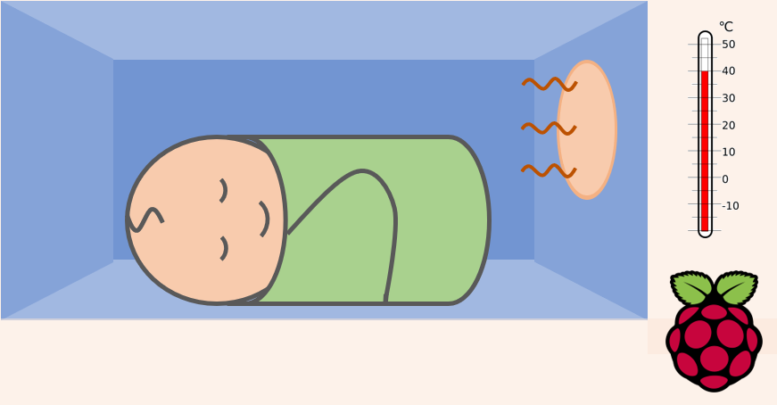
PWM Fan Operation
- Adjusts automatically to temperature fluctuations
- Disperses heat through incubator

